Slide 1
Database Concepts

Slide 2
Topics Covered
Introduction to DBMS
Why we need DBMS ?
Areas where DBMS are used.
Three level of abstraction
Schema and Instance
Data Models
DBMS - Architecture

Slide 3
Introduction to DBMS
Data : facts or information in the form of text, video, images, etc.
Database : collection of inter-related data which helps in efficient retrieval, insertion and deletion of data.
Database Management System : technology for creating and managing databases.
DBMS is a software tool to organize (create, retrieve, update and manage) data in a database.
Eg : Oracle, MySQL, MongoDB, Cassandra, ..etc

Slide 4
Why we need databases ?
Database management system contains information about a particular enterprise.
Collection of interrelated data.
A set of programs which access and manipulate that data
An environment for convenient as well as efficient use of data

Slide 5
DB Management Terminologies
Redundancy of data: Data is said to be redundant if same data is copied at many places.
Inconsistency of Data: Data is said to be inconsistent if multiple copies of same data does not match with each other.
Unauthorized Access: File System may lead to unauthorized access to data.
Concurrent Access: The access of same data by multiple users at same time is known as concurrency.
Backup and Recovery: backup and recovery of data if a Data is lost or corrupted.

Slide 6
Drawbacks : File Systems to store & manage data
Redundancy and inconsistency.
Difficulty in accessing the data
Integrity
Atomicity : either that operation happens or if it happens then it happens in full in totality, whereas otherwise it may not happen at all.
Concurrency of access
Security

Slide 7
Areas where DBMS are used
Airlines: reservations, schedules, etc
Telecom: calls made, customer details, network usage, etc
Universities: registration, results, grades, etc
Sales: products, purchases, customers, etc
Banking: all transactions etc

Slide 8
Three level of abstraction
Physical level which describes how a record is actually stored, so that is about the physical storage in the system.
Physical level typically is in terms of database files is binary in nature, the organization of those files( B+ trees, hashing ).
Logical level which describes the data stored in databases and its relationship amongst the data.
The logical level deals with the records and the different fields of the records the schema of the database
Topmost level is called the view level where the application program tries to view the data.

Slide 9
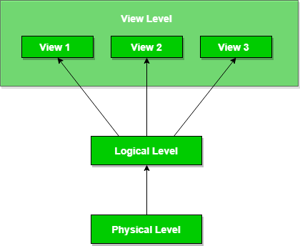
Three Level of Abstraction

Slide 10
Data Abstraction
Achieving data independence in order to save time and cost required when the database is modified or altered.
Physical level data independence : able to modify the physical schema without any alterations to the conceptual or logical schema
Conceptual structure of the database would not be affected by any change in storage size of the database system server.
Changing from sequential to random access files is one such example
Logical level data independence : able to modify the logical schema without affecting the external schema or application program
These changes may include insertion or deletion of attributes,
altering table structures entities or relationships to the logical schema etc.

Slide 11
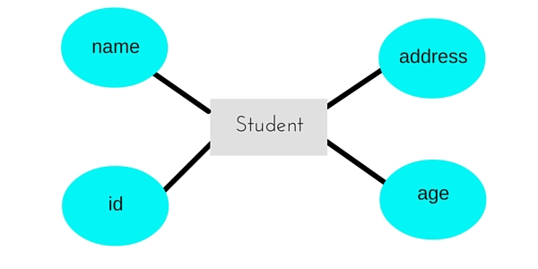
Schema and Instance
Logical schema : logical structure of the data it is a way a certain data needs to be organized, it is a plan for organizing data.
Physical schema: which tells actually how the data is physically organized in the database, what are the different database files, how they are indexed
All these information which we can say is kind of a metadata information So, this schematic or this metadata is called the Schema of a database
Instance : actual content of the database at any point of time.

Slide 12
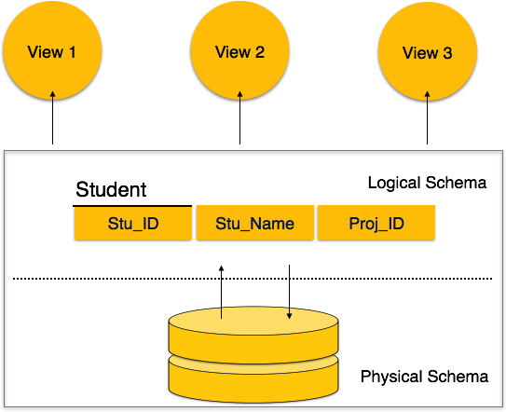
Schema and Instance

Slide 13
Database Models
Database model defines the logical design and structure of a database
Collection of tools that describe the data, data constraints, Data relationship, Data Semantics
While the Entity-Relationship & Relational Model is the most widely used database model, there are other models too:
Hierarchical Model
Network Model
Semi-Structured Model

Slide 14
Entity-Relationship Model
Based on the notion of real-world entities and relationships among them.
ER Model is based on −
Entities and their attributes.
Relationships among entities.
Entity − An entity in an ER Model is a real-world entity having properties called attributes. Every attribute is defined by its set of values called domain.
Relationship − The logical association among entities Relationships are mapped with entities in various ways. Mapping cardinalities define the number of association between two entities.

Slide 15
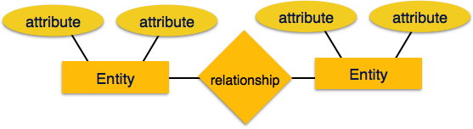
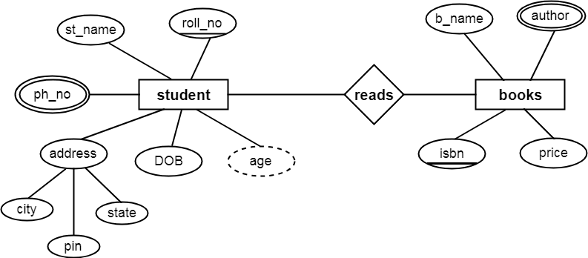
Entity-Relationship Model Example

Slide 16
Relational Model
Organize data into tables, also known as relations, each of which consists of columns and rows.
Each column lists an attribute of the entity in question, such as price, zip code, or birth date
Data is stored in tables called relations.
Relations can be normalized.
In normalized relations, values saved are atomic values.
Each row in a relation contains a unique value.
Each column in a relation contains values from a same domain.

Slide 17
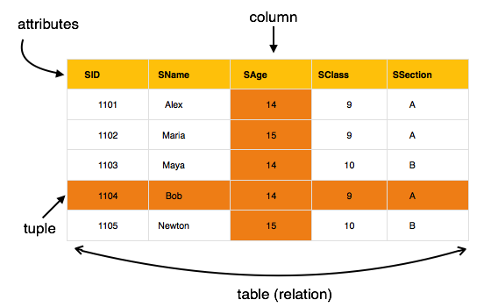

Slide 18
Hierarchical Model
Organises data into a tree-like-structure
A single root, to which all the other data is linked. The heirarchy starts from the Root data, and expands like a tree, adding child nodes to the parent nodes.
Model efficiently describes many real-world relationships like index of a book, recipes etc.

Slide 19
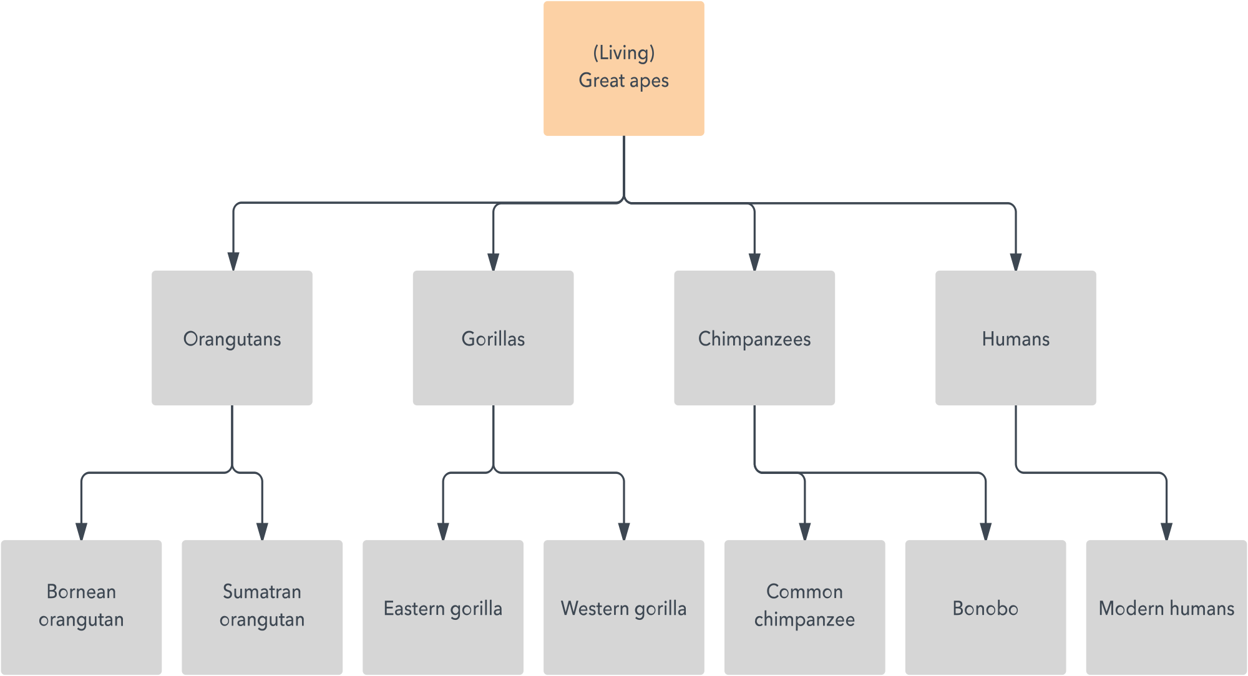
Hierarchical Model

Slide 20
Network Model
Organises data a more like a graph, and are allowed to have more than one parent node.
data is more related as more relationships are established in this database model.
many-to-many relationships between linked records

Slide 21
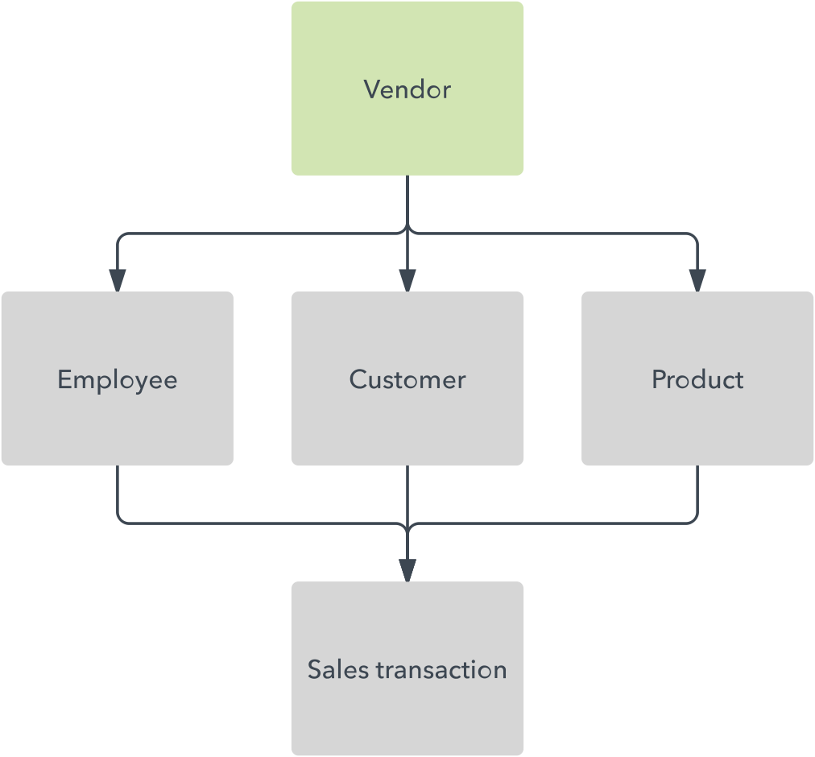
Network Model

Slide 22
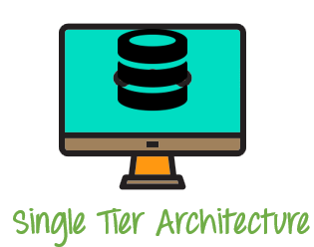
DBMS Architecture
1-tier architecture
Only entity where the user directly sits on the DBMS and uses it
Anytime you install a DB in your system and access it to practise SQL queries it is 1 tier architecture

Slide 23
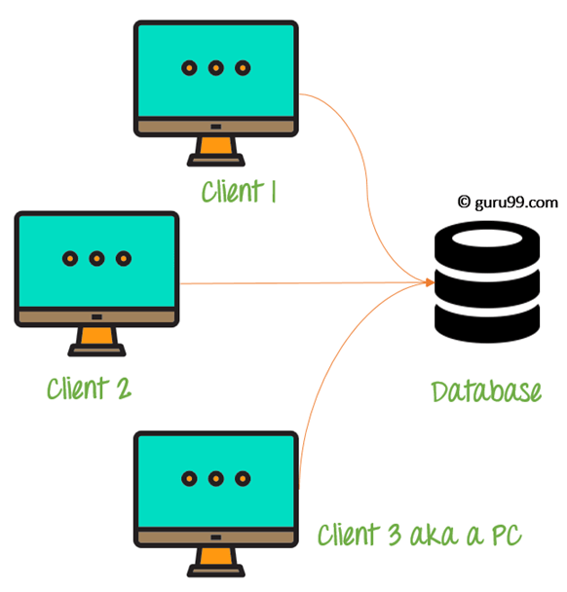
DBMS Architecture
2-tier architecture
Presentation layer runs on a client (PC, Mobile, Tablet, etc)
Data is stored on a Server.
An application interface allows the client-side program to call the DBMS.
2 tier architecture provides added security to the DBMS as it is not exposed to the end user directly

Slide 24
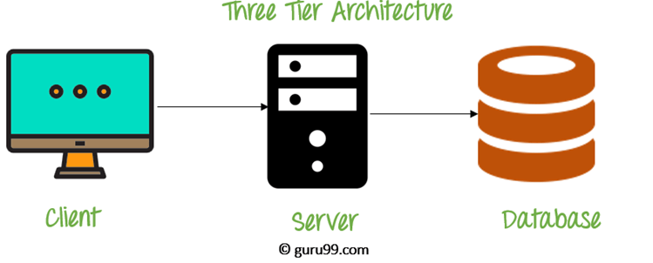
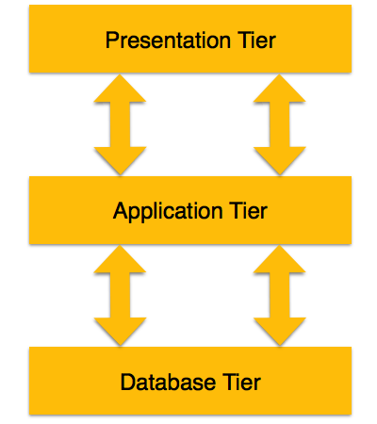
DBMS Architecture
3-tier architecture
Database (Data) Tier − At this tier, the database resides along with its query processing languages Data is stored on a Server.
Application (Middle) Tier − At this tier reside the application server and the programs that access the database and business logic
User (Presentation) Ti er − At this layer, multiple views of the database can be provided by the application.

